Slide 1
Spotify Project
Group B1:
Harsha Vinoy, Kaixin Yang, William Powell, Connor Scherer

Slide 2
Description
Analyze music data in order to be able to make a prediction about future hits in the US and globally.

Slide 3
Our Questions
How do music trends compare between different countries around the world?
What are some of the trends around popular songs and artists specifically in the US throughout recent years on Spotify.
How does Spotify data compare with The Billboard Hot 100?
Can data of past hit songs be used to make a hit song “formula”?

Slide 4
Cleaning the Data
We pulled our data from CSV files on Kaggle.
From there we combined DataFrames where necessary and removed extraneous columns.
We wrote our code using Jupyter Notebook as the writer where we imported Pandas, Numpy, Sklearn, Scistats, and Matplotlib.

Slide 5
Terms to Look For:
Danceability- describes how suitable a track is for dancing based on a combination of musical elements including tempo, rhythm stability, beat strength, and overall regularity. A value of 0.0 is least danceable and 1.0 is most danceable.
Energy- is a measure from 0.0 to 1.0 and represents a perceptual measure of intensity and activity. Typically, energetic tracks feel fast, loud, and noisy. For example, death metal has high energy, while a Bach prelude scores low on the scale. Perceptual features contributing to this attribute include dynamic range, perceived loudness, timbre, onset rate, and general entropy.
Acousticness- is a confidence measure from 0.0 to 1.0 of whether the track is acoustic. 1.0 represents high confidence the track is acoustic.
BPM- is Beats Per Minute

Slide 6
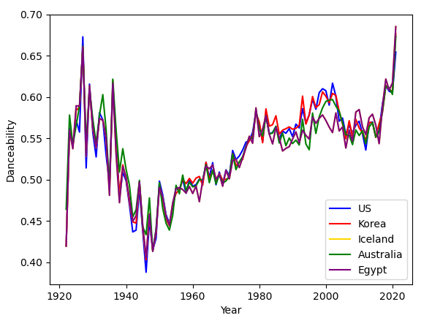
Globally Various Danceability
This chart shows the danceability over the years of 5 countries: The US, Korea, Iceland, Australia, and Egypt.
Note how they follow a similar trend.

Slide 7
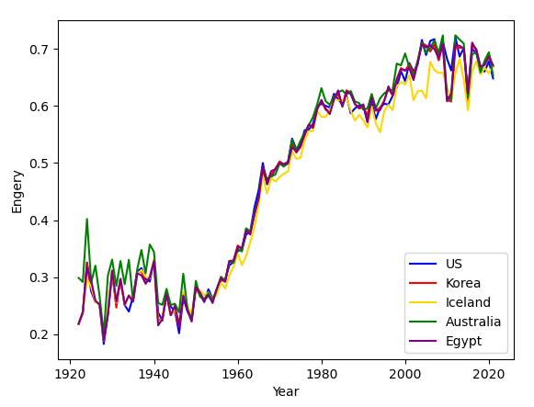
Globally Various Energy
This chart shows how the energy of music has changed over the same time period as the first chart in the same countries.
Note how they follow a similar trend.

Slide 8
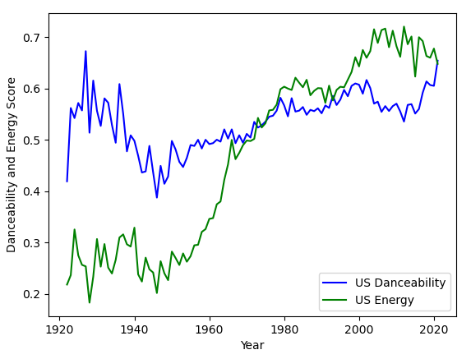
US Energy vs Danceability
This chart is a focused look at how danceability and energy have changed over the years in the US specifically.
Note how they are currently intersecting.

Slide 9
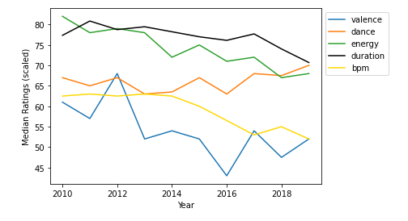
Qualities of hit songs - Connor
This chart compares the median rating for 5 different attributes of the top songs from 2010 through 2019
The trends may indicate popular songs are getting simpler and sadder over time

Slide 10
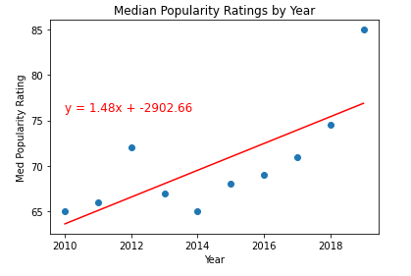
This chart shows the median popularity rating of the top songs from 2010 through 2019
The upward trend could indicate popularity is accumulating into fewer songs over time
*it could also indicate flaws in the dataset, as each year did not have the same number of songs

Slide 11
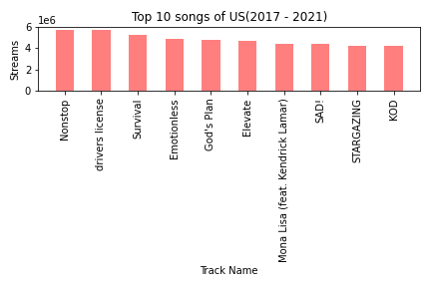
Top 10 popular songs on Spotify (US) - Kaixin
This bar chart shows the Top 10 popular (most-streamed) songs in the U.S. on Spotify over the last five years
The second song “Drivers License” is a pop song, the other 9 songs are all hip-hop songs.
Canadian singer/rapper Drake has 4 songs on top 5 of US chart.

Slide 12
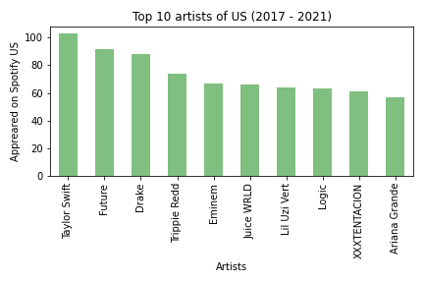
Top 10 popular artists on Spotify( US) - Kaixin
This chart presents the most frequently appeared artists on the "Top 200" charts in the U.S. on Spotify over the last 5 years.
8 of 10 artists in this bar chart are rappers, and
the other 2 artists (Taylor Swift and Ariana Grande) are pop stars.

Slide 13
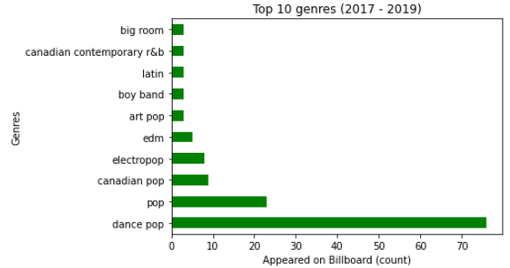
US Billboard - Top Genres
Main question: How does Spotify data compare with The Billboard Hot 100?
Billboard rankings:
Sales
Radio play
Online streaming
-Spotify vs Billboard Genres

Slide 14
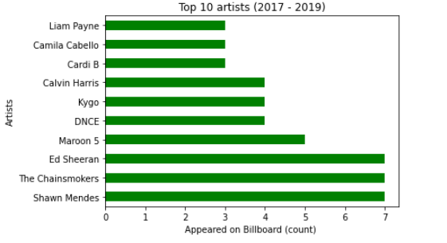
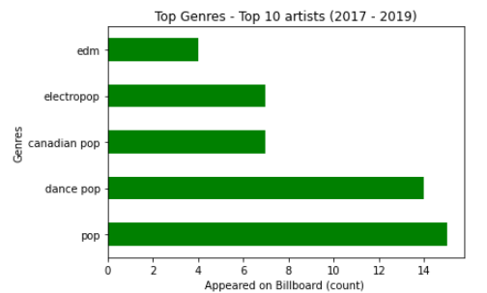
US Billboard - Top Artists and Genres
Popular Spotify Artists vs Billboard Artists

Slide 15
Conclusions
Our data suggests that music trends around the globe are universal.
This allows us to look specifically at the US and determine what artist or genre will be popular next year.
Danceability and Energy are very important in the making of a popular song, with Danceability being the most important.
Hip-Hop music and Pop music are very popular in America on Spotify.
Pop songs have a higher number of appearances in the billboard charts than any other genres.

Slide 16
Our Answer - Next Global Hit
Dance Pop Genre

